Slide 1

Predicting NBA Awards
Clay Kindiger and Haoyang Pang

Slide 2
Awards
The MVP, Most Valuable Player, Award
Awarded to the player who has the largest impact on their team
The DPOY, Defensive Player of the Year, Award
Awarded to the player who has the largest impact on defense

Slide 3

Data
For this project, we scraped Basketball Reference to get individual stats, team stats, as well as the winners of the awards for each year from 1998-2022
The small number of award winners in our data could cause some poor results, so, if needed, we will add more data to our dataset
We could also look at the award voting recipients

Slide 4
Our Plan
MVP - use individual stats, like Points, Rebounds, and Assists, as well as team success stats, like wins and losses, and whether the team made the playoffs
DPOY - use individual stats, like Rebounds, Steals, and Blocks, as well as team defensive rating, and team success
With these stats, we will create several different types of classification models to predict which players will win each of these awards
We will train on 20 random years of data and test with the other 5 years

Slide 5
Model Evaluation
F1 Score
Did the model accurately predict the MVP/DPOY?
Cross validation
Do the results change depending on the training data selected?

Slide 6
Data Preprocessing
We will normalize stats on a year-to-year basis to account for changes within the NBA
Rise of the 3 pointer
Faster Pace

Slide 7
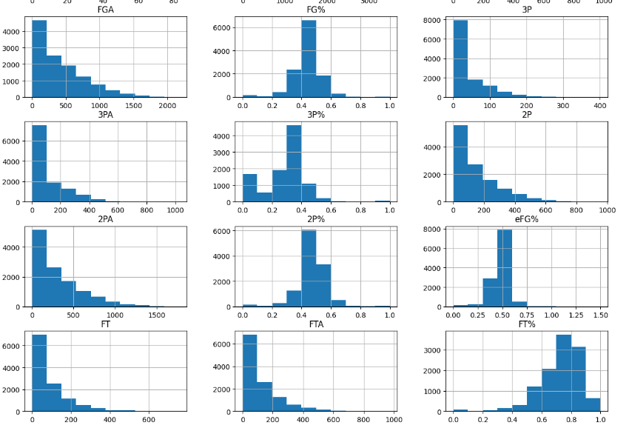
EDA

Slide 8

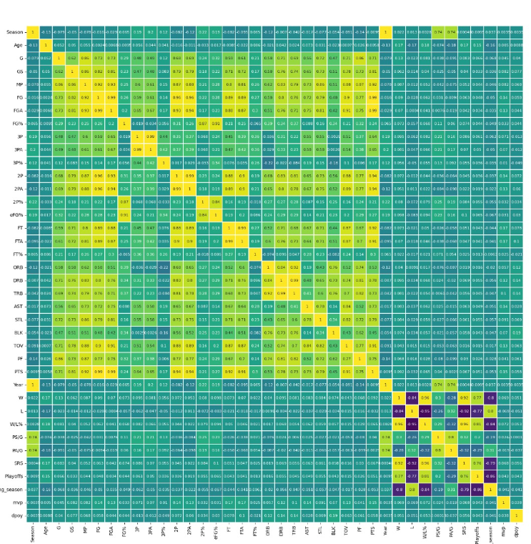
Correlation Heatmap

Slide 9
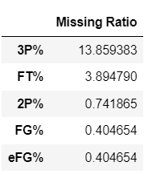
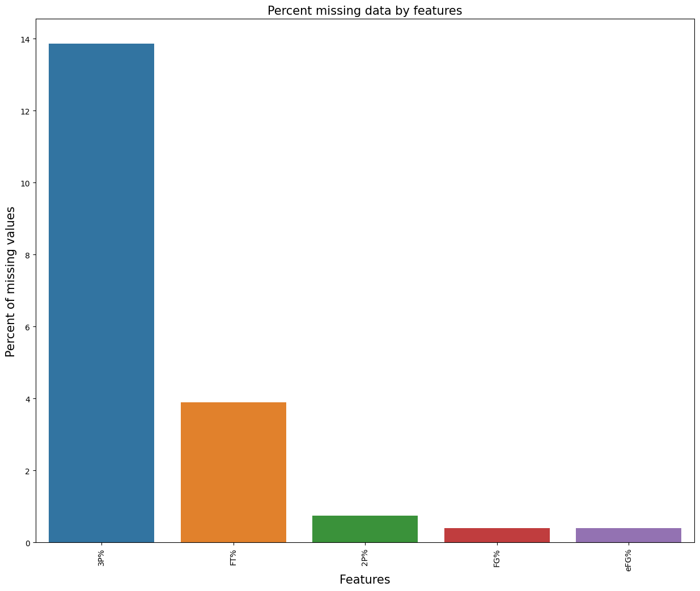
Missing Ratio

Slide 10
Removing Players
Players with 0% Effective Field Goal Percentage
These players made no shots during the NBA season, so they will not be eligible for the awards

Slide 11
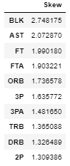
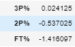
Skewness
There are 33 skewed features, justify to use Box Cox

